Slide 1
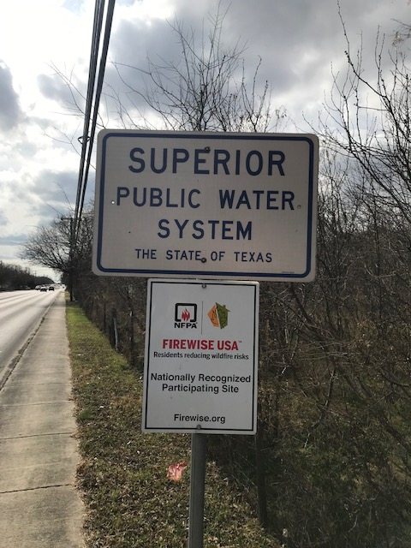
Enterprise Fund
State of the System
Melinda Moritz, David Dimaline
Director & Assistant Director Public Works
Town Hall Meeting
January 25, 2025

Slide 2
Purpose
To explain Enterprise Fund system & components
To explain Enterprise Fund revenues and expenses
To explain Enterprise Fund Maintenance, Replacement, & Capital Improvement Plan

Slide 3
Prudent Management Practices
City should maintain a prioritized list of main repairs & replacements & update every 5 years
City should continue to build & keep adequate reserves for emergencies & for future replacement of capital items
City should continue to review water & sewer rates each year to keep up with inflation & to fund future repair/replacement costs
City should continue to save/apply for grant funding for future improvements to system & customer service
City should continue to purchase water rights for future development & Critical Period Drought Management reductions

Slide 4
The System
Water/Sewer Utility – 1810.474-acre feet (AF) of water rights, 2 Edwards Aquifer water wells & related motors/pumps/VFD’s, 3 elevated water storage tanks, 1 above ground water storage tank, 2 emergency generators, 1 SCADA system, approx. 39 miles of water mains/43 miles of sewer mains, 261 water valves, approx. 2600 - 2700 corporations & water meters, 304 fire hydrants, 903 manholes, meter reading equipment, vehicles, & other equipment
Personnel – 4-man Crew, Utility Billing Manager, & portions of salaries from other departments
  City Manager & Assist. City Manager, Public Works Director & Assist. PW Director, Finance Director & Assist. Finance Director, court clerks, etc.
Stormwater Utility – city drainage system, Huebner Creek, Zarzamora Creek, vehicles and equipment, use personnel from Public Works, Water, and other departments

Slide 5
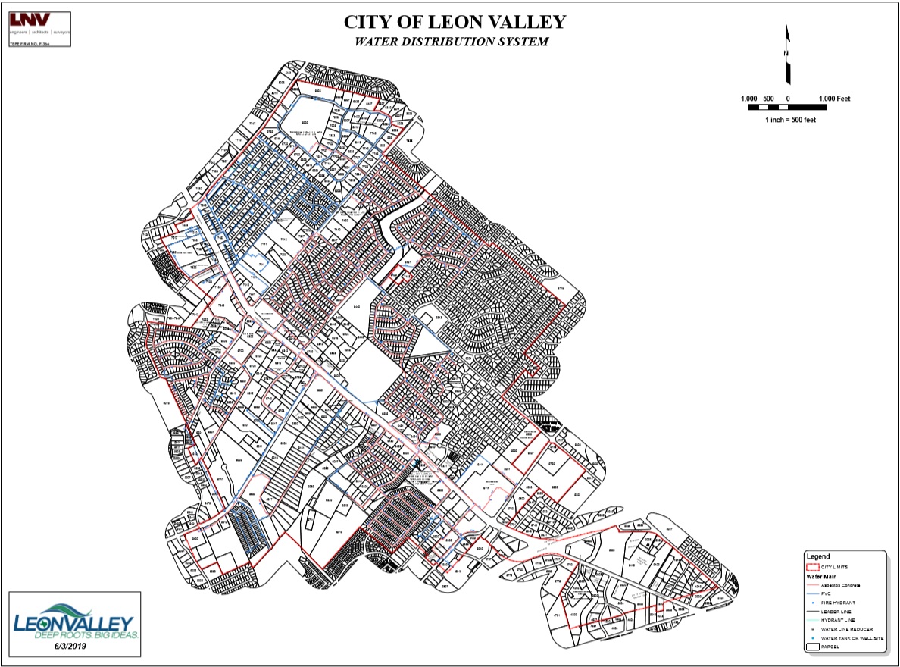
Water Map

Slide 6
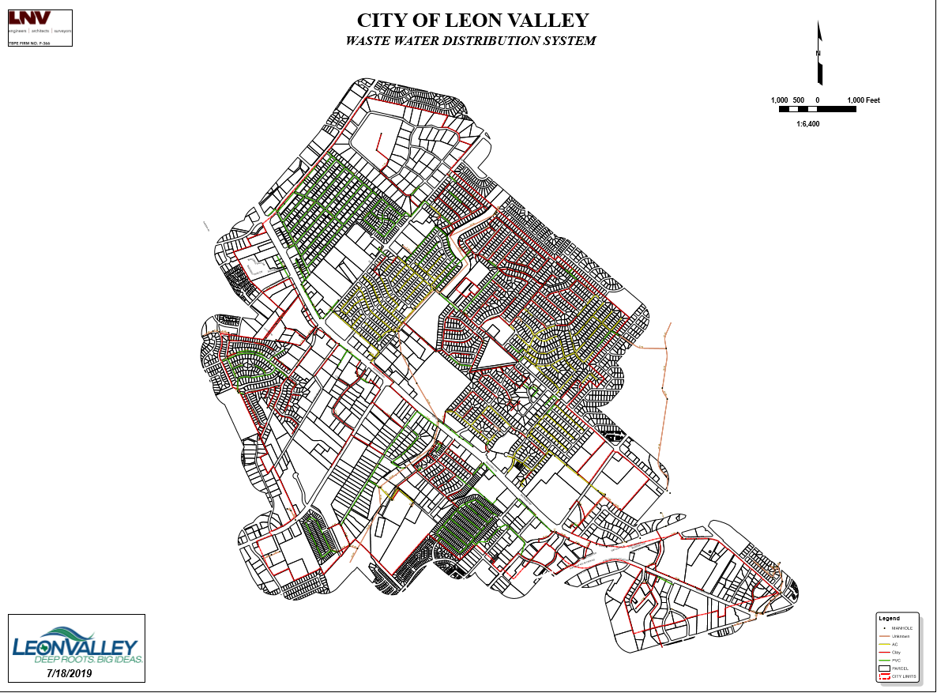
Wastewater Map

Slide 7
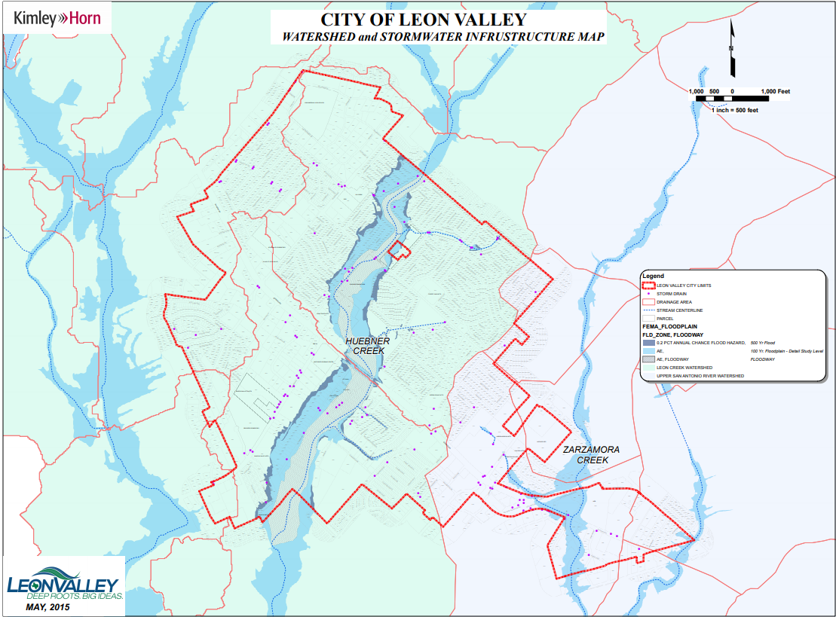

Slide 8
Rates, Revenues, Expenses
No utility systems are the same – each have varying revenue requirements to meet expenses & system needs
Rate & fee structures monitored yearly to assure adequate funds collected to maintain system & provide for future improvements
Dedicated amount of revenue should remain in reserve to allow for 3-6 months of operating expenses, in case of a disaster
Impact fees reviewed every 5 years to assure requirements for new development are being met
  Just reviewed in November & increased

Slide 9
The Rates
Monthly meter charge
Monthly volumetric rate (per thousand gallons)
Commercial
0–500,000 $3.70
Above $3.95
Residential
0–3,000 $3.56
3,001–6,000 $5.06
6,001–10,000 $6.56
10,001–17,000 $8.06
Above 17,001 $9.56
Irrigation
0–3,000 $3.56
3,001–6,000 $5.06
6,001–10,000 $6.56
10,001–17,000 $8.06
Above 17,001 $9.56
Meter Size | Fee
Residential 5/8" | $11.76
Commercial 5/8" | $12.30
Residential 3/4" | $13.39
Commercial 3/4" | $15.08
1" | $19.06
1-1/2" | $30.72
2" | $45.28
3" | $129.41
4" | $164.71
8" | $616.73

Slide 10
The Rates
Edwards Aquifer Authority fee: $0.62/1,000 gal
  Mandated by law to collect – pass through
Water supply fee: $0.50/1,000 gal
  Own 1,810.47-acre feet - goal is to own 2,054-acre feet or more, for future development and Stage 4 water restriction reductions (40%)
TCEQ: $0.20/mo. per connection
Monthly sewer service rates, residential and nonresidential
  Minimum bill residential: $15.08 first 1,000 gal
  Minimum bill commercial: n/a
  Volumetric rate: $6.24/1,000 gal
  Winter sewer averaging – calculated each year, based on water usage from November 15th to February 15th for residential usage, then that average is used the rest of the year, barring any rate increases

Slide 11
The Rates
Examples of monthly bills:
3,000 Gal 5,000 Gal 10,000 Gal
Water $22.44 $32.56 $63.86
Sewer* $27.56 $40.04 $71.24
EAA $1.86 $3.10 $6.20
Water supply $1.50 $2.50 $5.00
Stormwater $3.68 $3.68 $3.68
TCEQ $0.20 $0.20 $0.20
Total $57.24 $82.08 $150.48
* Assuming winter average of water usage example

Slide 12
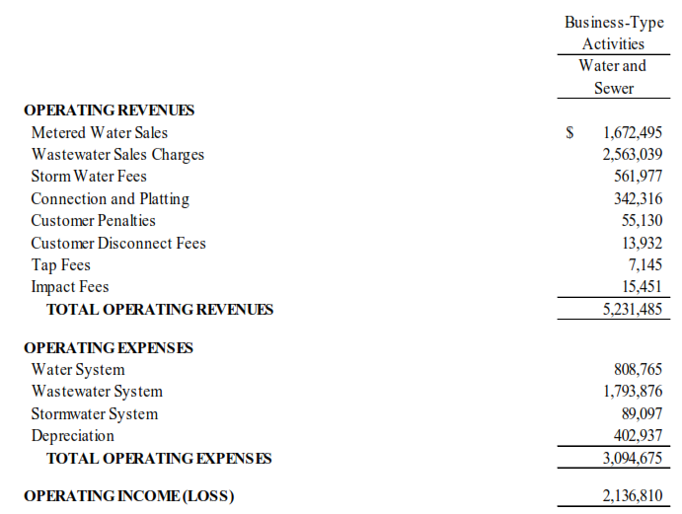
Revenues & Expenditures FY 23

Slide 13
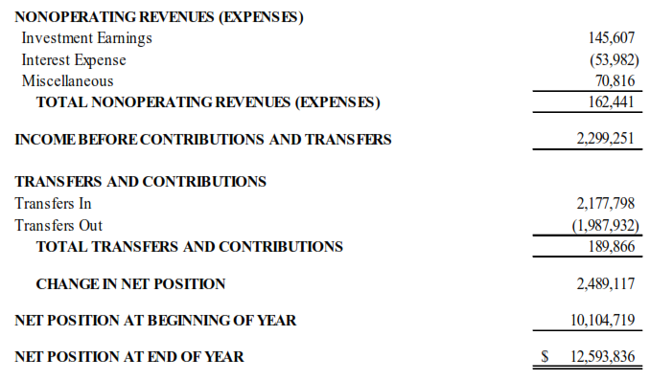
Revenues & Expenditures FY 23

Slide 14
Fund Reserve Notes
FY 22-23 (as of 9/30/23)
Water & Sewer System $2,062,571*
Yearly operating expenses $3,094,675
Monthly operating costs $ 257,890
Planning for emergencies:
  x 3 months operating costs $ 773,670
  x 6 months operating costs $1,547,340
Should keep for emergencies $1,000,000 (or more)
Already restricted $ 350,000
* Total subject to change. Remaining $1,418,398 is Stormwater fund reserve (as of 9/30/23), which is only used for Stormwater projects/emergencies

Slide 15
The Expenses - Summary

Slide 18
Expenses - Supplies

Slide 19
Expenses - Supplies

Slide 20
Expenses - Supplies

Slide 21
Expenses - Contractual

Slide 22
Expenses - Contractual

Slide 23
Expenses - Contractual

Slide 24
The Expenses - Capital

Slide 25
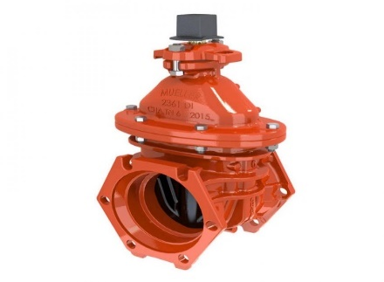
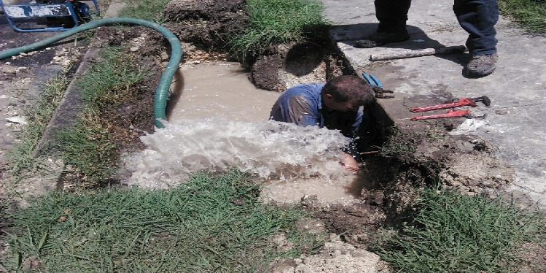
Future Expenses
Numerous items are in need of repairs:
  Old asbestos-concrete (AC) water mains need to be replaced and corporations (connection from main to customer), especially on older AC pipe, which are coming apart from the water mains
  Some existing water valves are malfunctioning, causing larger outage areas when mains are being repaired/replaced
  In some areas, fire hydrants are 40+ years old, and some don’t have cut off valves to perform repairs - all new hydrants have the Storz quick connections which assists the Fire Dept.

Slide 26
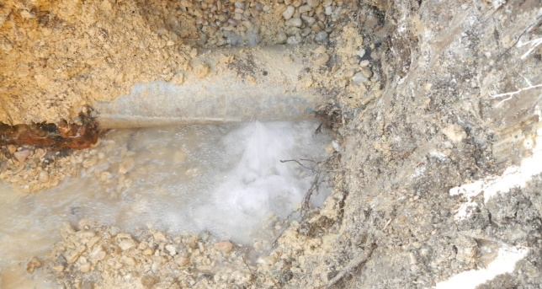
Project Summary
Monthly service reports detailing main and service line breaks from the past five years were tallied:
  Mains that had numerous repair calls were identified
  Identified neighborhoods in which fire hydrants were over 40 years old
  Identified area in which the water mains were not looped (dead end mains)
  Identified water valves that are malfunctioning or not working
  Identified areas where there are no sewer mains and customers could be connected to the sewer system
  Identified condition, rehabilitation, and replacement status for each water storage tank

Slide 27
Project Summary
Developed cost estimates for replacement, based on length, type, & condition
Developed cost estimates for new projects, such as sewer main connection & dead-end water main looping
Developed cost estimates for replacement of water tanks
We are also coordinating improvements with the Street Maintenance Program, so as to not cut newly maintained streets

Slide 28
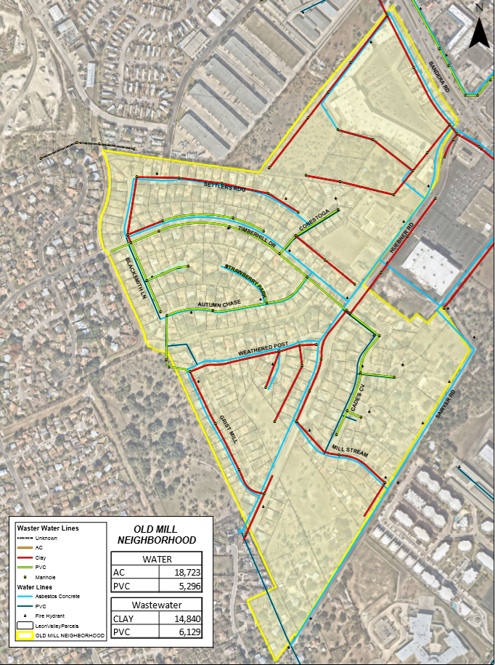
Updating neighborhood maps -
Identifies types & length of mains, other equipment

Slide 29
Fiscal Impact
Water Main replace (20.31 mi.) 107,267 LF
  Est. cost ($400-$600 per L.F.) $47,382,914
  Includes main, valves, fire hydrants, service lines, street repair, etc.
Sewer Main replace (20.48 mi.) 108,158 LF
  Est. cost ($600-$700 per L.F.) $67,572,848
  Includes main, laterals, manholes, cleanouts, etc.
    LF = linear feet
    Total $114,955,762

Slide 30
Fiscal Impact
Additional water rights 243-AF
  Estimated cost $2,673,000 ($11,000 per AF)
  Cost covered by Water Supply Fee on water bill
Marshall Elevated Tank (100,000 gal) Est. Replacement year 2042
  (built 1937)Estimated cost $1.25 million
  Rehabilitation year 2022 $311,600
Grass Hill GST (750,000 gal) Est. Replacement year 2040
  (1978) Estimated cost $2,000,000
  Rehabilitation year 2020
Taylor Elevated Tank (150,000 gal) Est. Replacement year 2043
  (built 1980)Estimated cost $2,000,000
  Rehabilitation year 2023
Grass Hill Elevated Tank (150,000 gal) Est. Replacement year 2041
  (built 1978) Estimated cost $2,000,000
  Rehabilitation Year 2021

Slide 31
Fiscal Impact - Summary
Item | Estimate
Water/Sewer Main Replacement, valves | $114,955,762
Water Rights (243 AF – funded through water supply fee & Impact Fees) | $2,673,000
Marshall Water Tank (Replace After next Rehab - 15-20 Years) | $1,250,000
Total | $118,878,762

Slide 32
Future Projects
Locker Lane Sewer Main 1,270 LF
  Estimated cost $762,000
  Connects 10 homes
Monte Robles Sewer Main 10,422 LF
  Estimated cost $6,253,200
  Connects 45 homes & some vacant properties
Dead end Water Looping 5,000 LF
  Estimated cost $2,500,000
Total Cost Future Projects $9,515,200

Slide 33
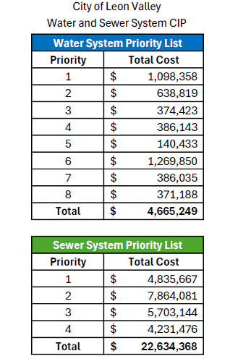
Prioritized List

Slide 34
Fiscal Impact – Priority Only
Item | Estimate
Water Main Replacement (Priorities 1-8) | $4,711,511
Sewer Main Replacement (Priority 1) | $3,659,018
Water Rights (243 AF – funded through water supply fee) | $2,673,000
Total | $11,043,529

Slide 35
Fiscal Impact
Enterprise Fund borrowed $2,000,000 in FY 16 for 2 new wells and related equipment - debt service is approx. $105,000 to $135,000 annually
Water & sewer rates were increased to cover the cost of the debt service for these improvements
Purchased water rate software to measure repair vs rate impact each year to supply adequate income for repairs/improvements
Consider increasing rates again to keep up with inflation & cost of living

Slide 36
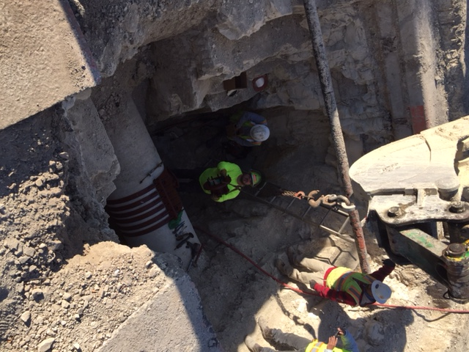
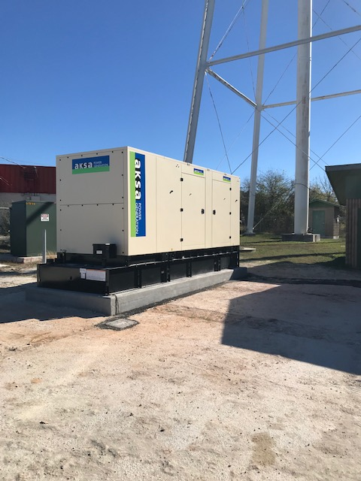
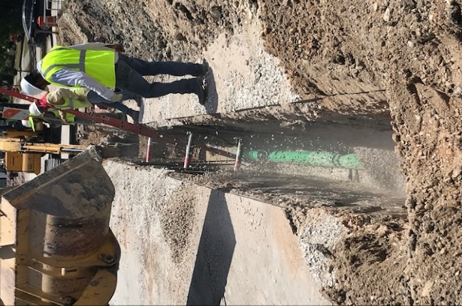
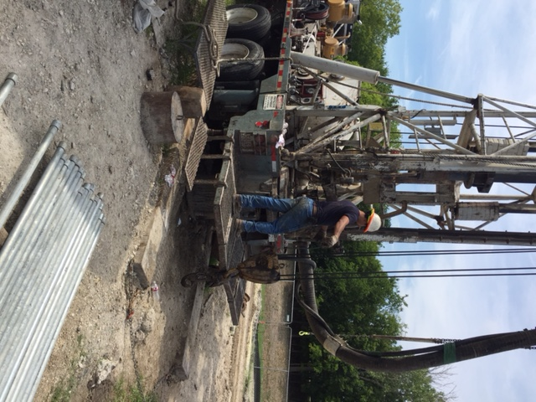
Improvements

Slide 37
Projects Scheduled – Next 2 Years
2024/25 Projects:
  CDBG - Replace portion of sewer main along Wurzbach (completed)
  CDBG - replace sewer mains East of Wurzbach
  Replaced sewer along Stirrup Lane
  Purchase 105-acre feet of water rights
2025/26 Projects
  CDBG – replace sewer main in alley behind Cammie Way St.
  Water Main and Sewer Main Replacement Program (Priority List)
  Purchase 15-AF feet of water rights

Slide 38
Plan for Future Years
Continue Water and Sewer Main Replacement Plan
Continue to apply for CDBG funds for water and sewer main replacement
Continue to build reserves for emergencies, repairs, & future replacement of water tanks
Determine cost/benefit of changing to AMI metering system (currently $1,000,000 +/-)
Add Crewmember to existing Water Crew
Determine funding sources for needed repairs/replacements
Continue to purchase water rights

Slide 39
Next Steps
Analyze current fee and rate structure
Propose funding options
City Council to decide most prudent option
Move forward with approved option

Slide 40
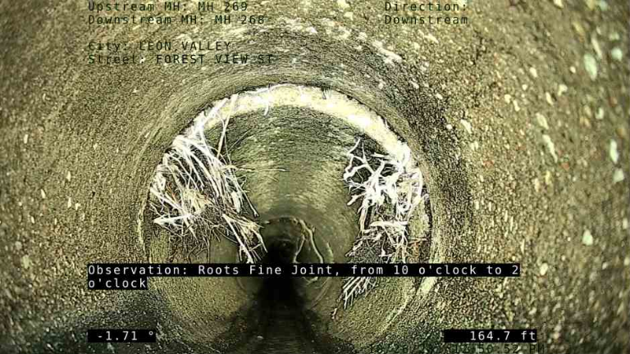
Forest View

Slide 41
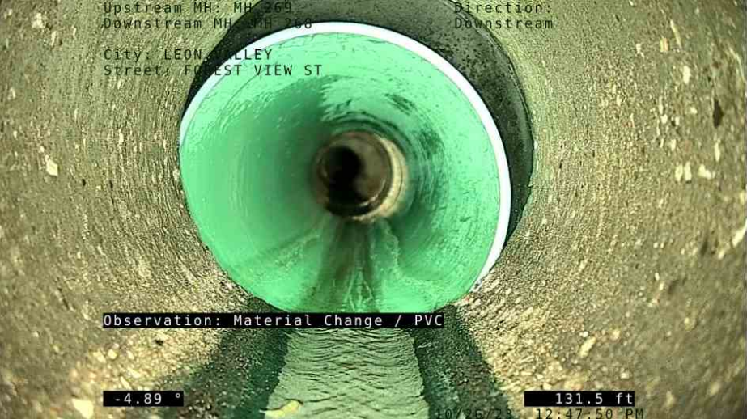
Forest View

Slide 42
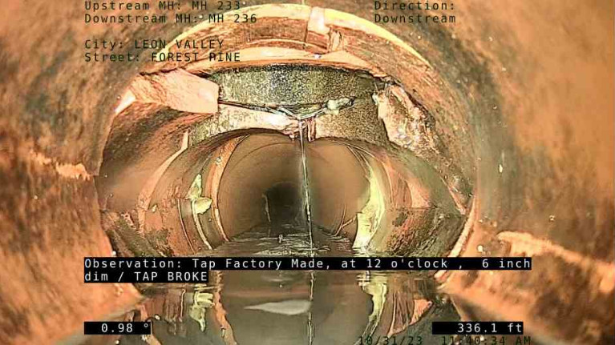
Forest Pine

Slide 43
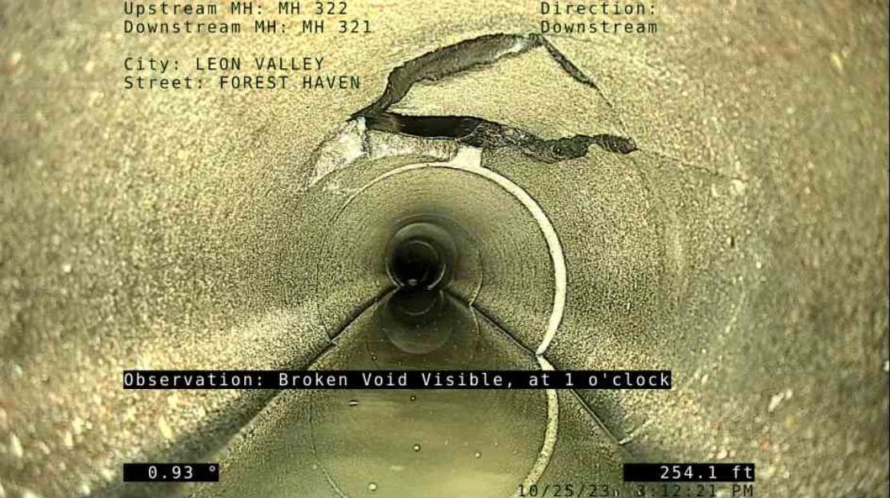
Forest Haven

Slide 44
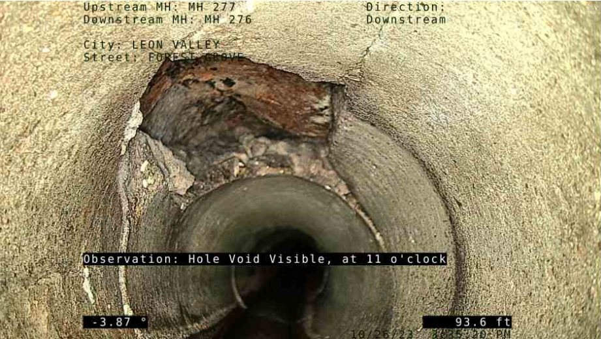
Forest Grove

Slide 45
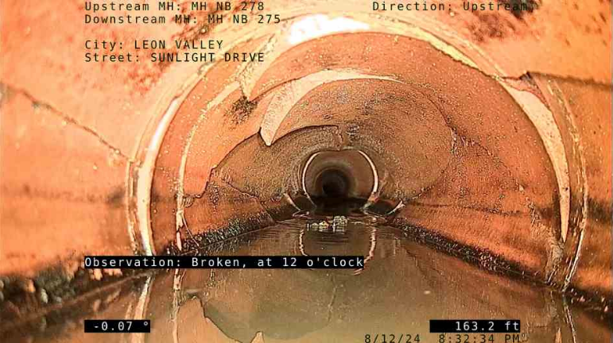
Sunlight

Slide 46
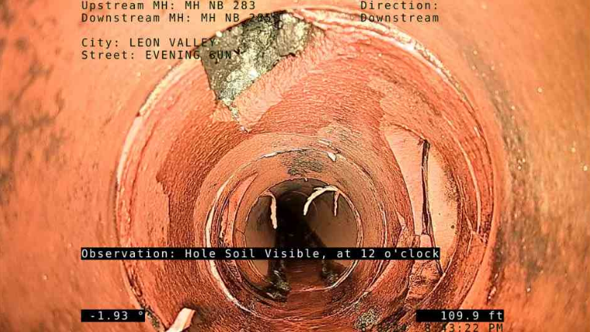
Evening Sun

Slide 47
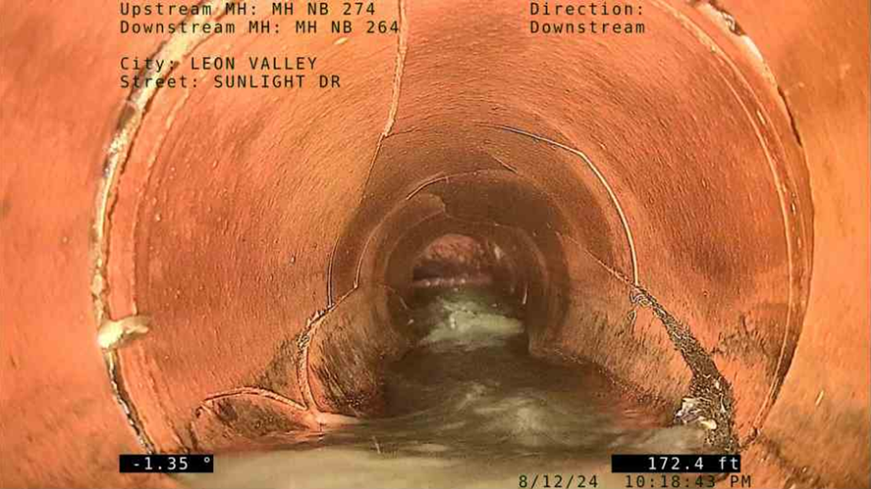
Evening Sun

