Slide 1
LEON VALLEY
Notes:
Divider Page 1

Slide 2
About Meritage Homes Corporation
Meritage Homes is the fifth-largest public homebuilder in the United States, based on homes closed in 2022. Operations span across Arizona, California, Colorado, Texas, Florida, Georgia, North Carolina, South Carolina, Tennessee and Utah.
Meritage Homes has delivered over 175,000 homes in its 37-year history, and has a reputation for its distinctive style, quality construction, and award-winning customer experience. The Company is an industry leader in energy-efficient homebuilding, a ten-time recipient of the U.S. Environmental Protection Agency’s ("EPA") ENERGY STAR® Partner of the Year for Sustained Excellence Award since 2013 for innovation and industry leadership in energy-efficient homebuilding, and the recipient of the EPA's 2023 Market Leader Award for Certified Homes as well as the EPA's 2023 Indoor airPLUS Leader Award.
For more information, visit www.meritagehomes.com.

Slide 3
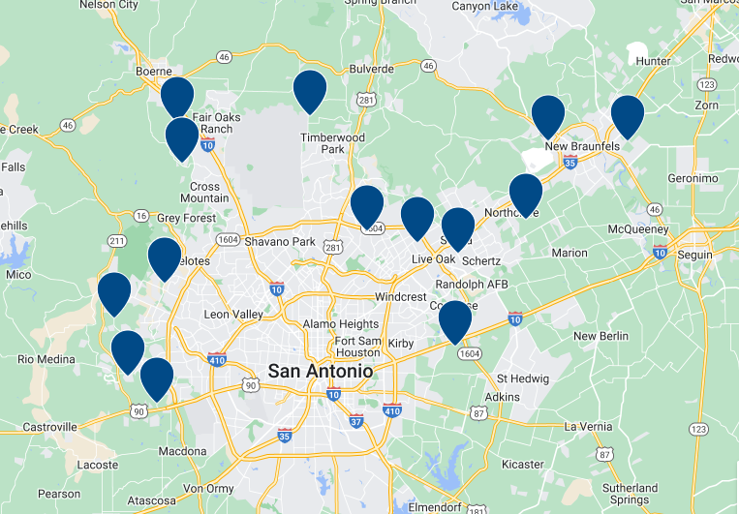
San Antonio Area Communities

Slide 4
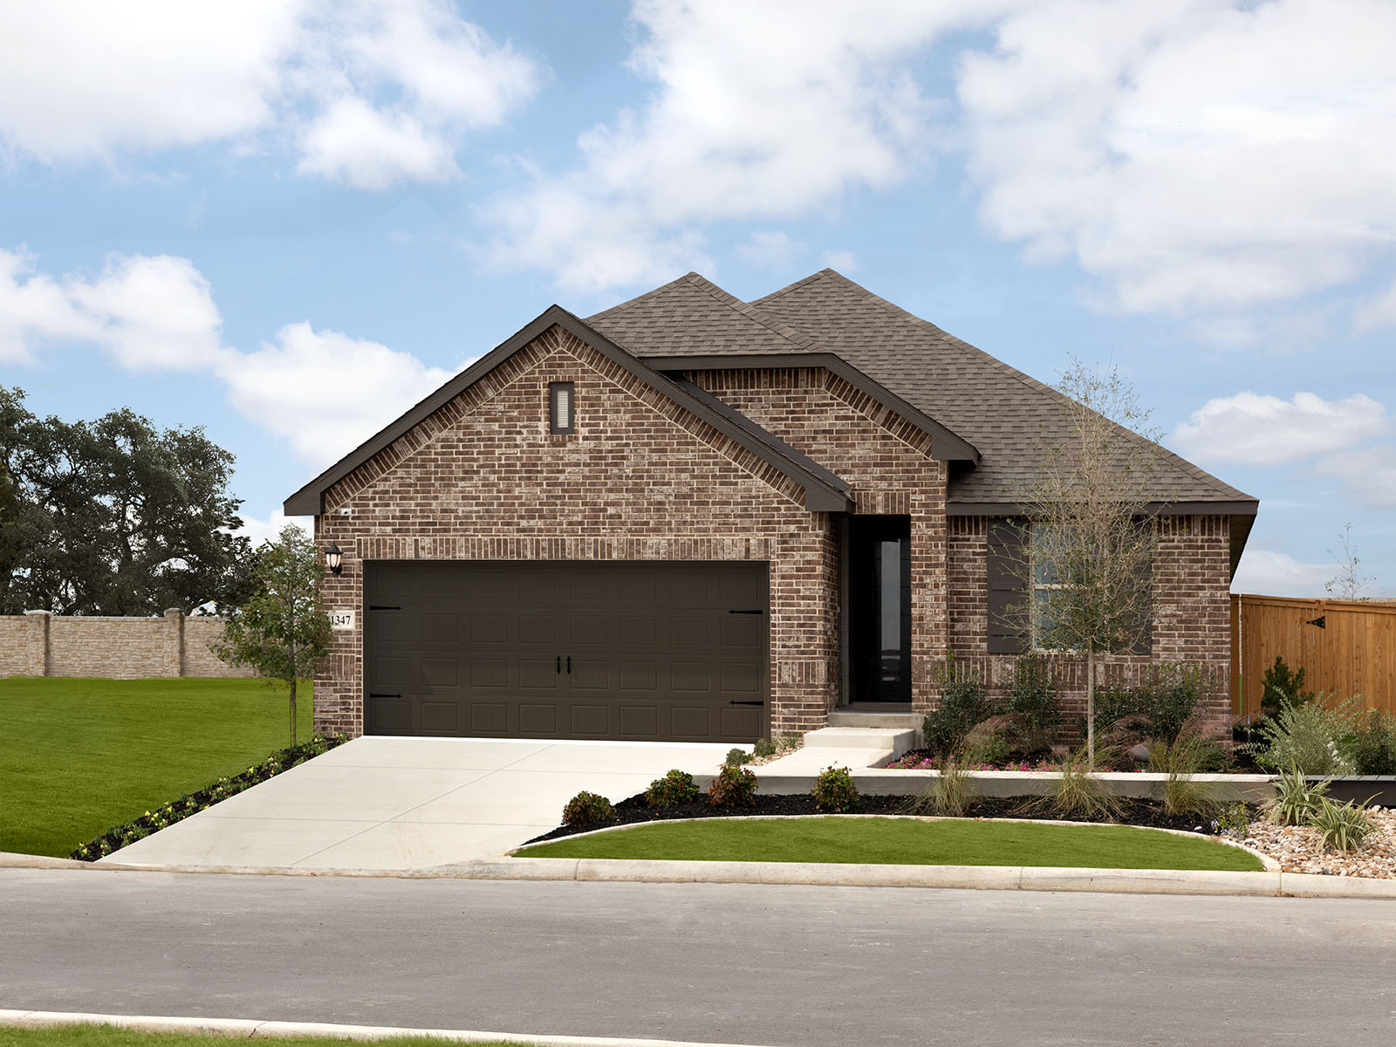
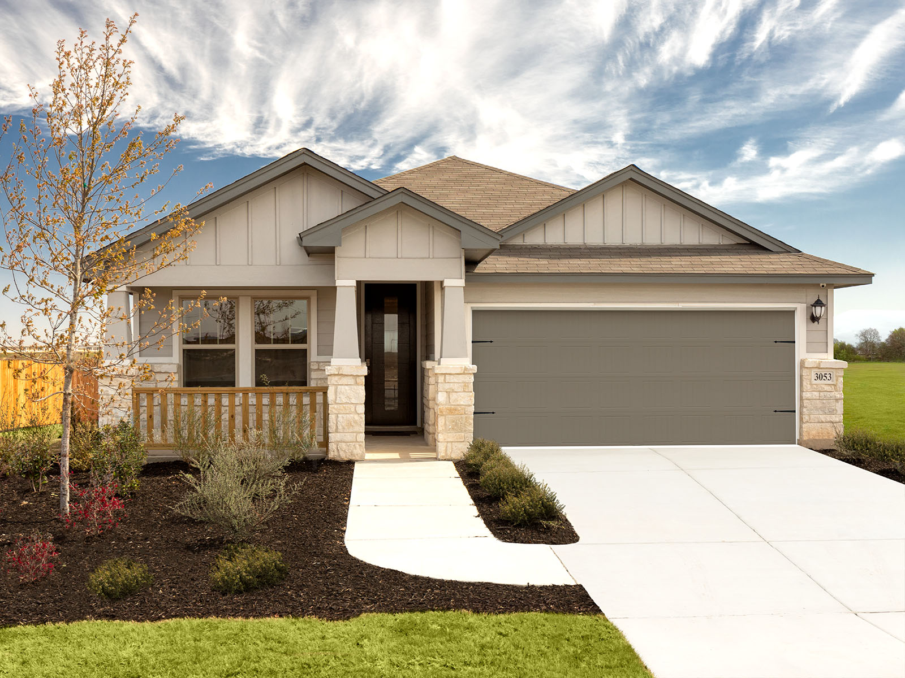
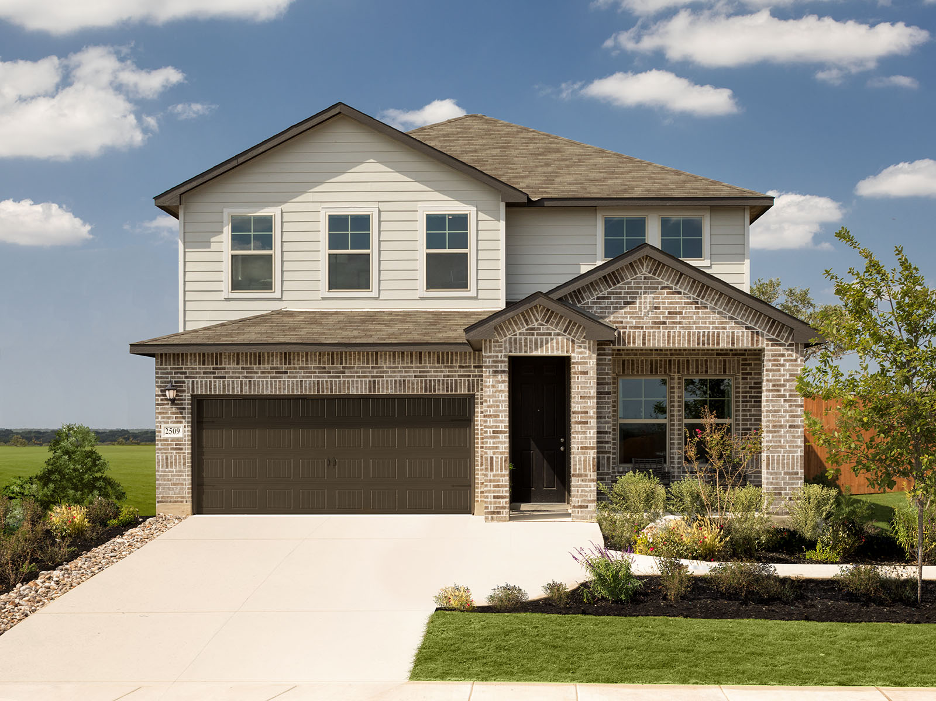
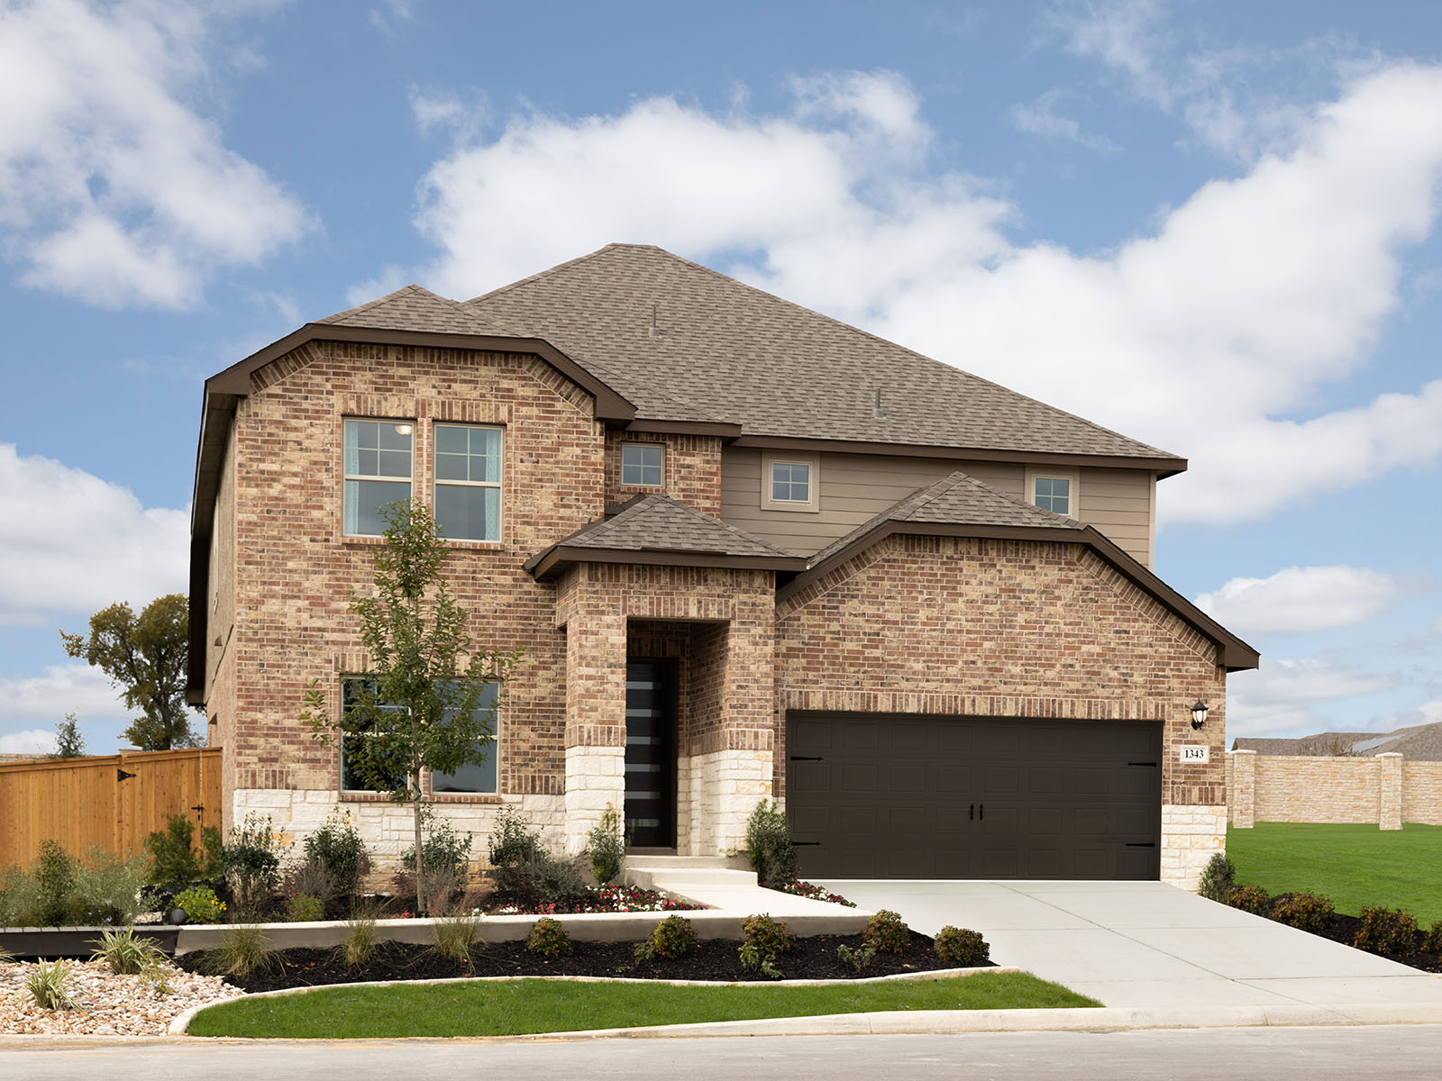
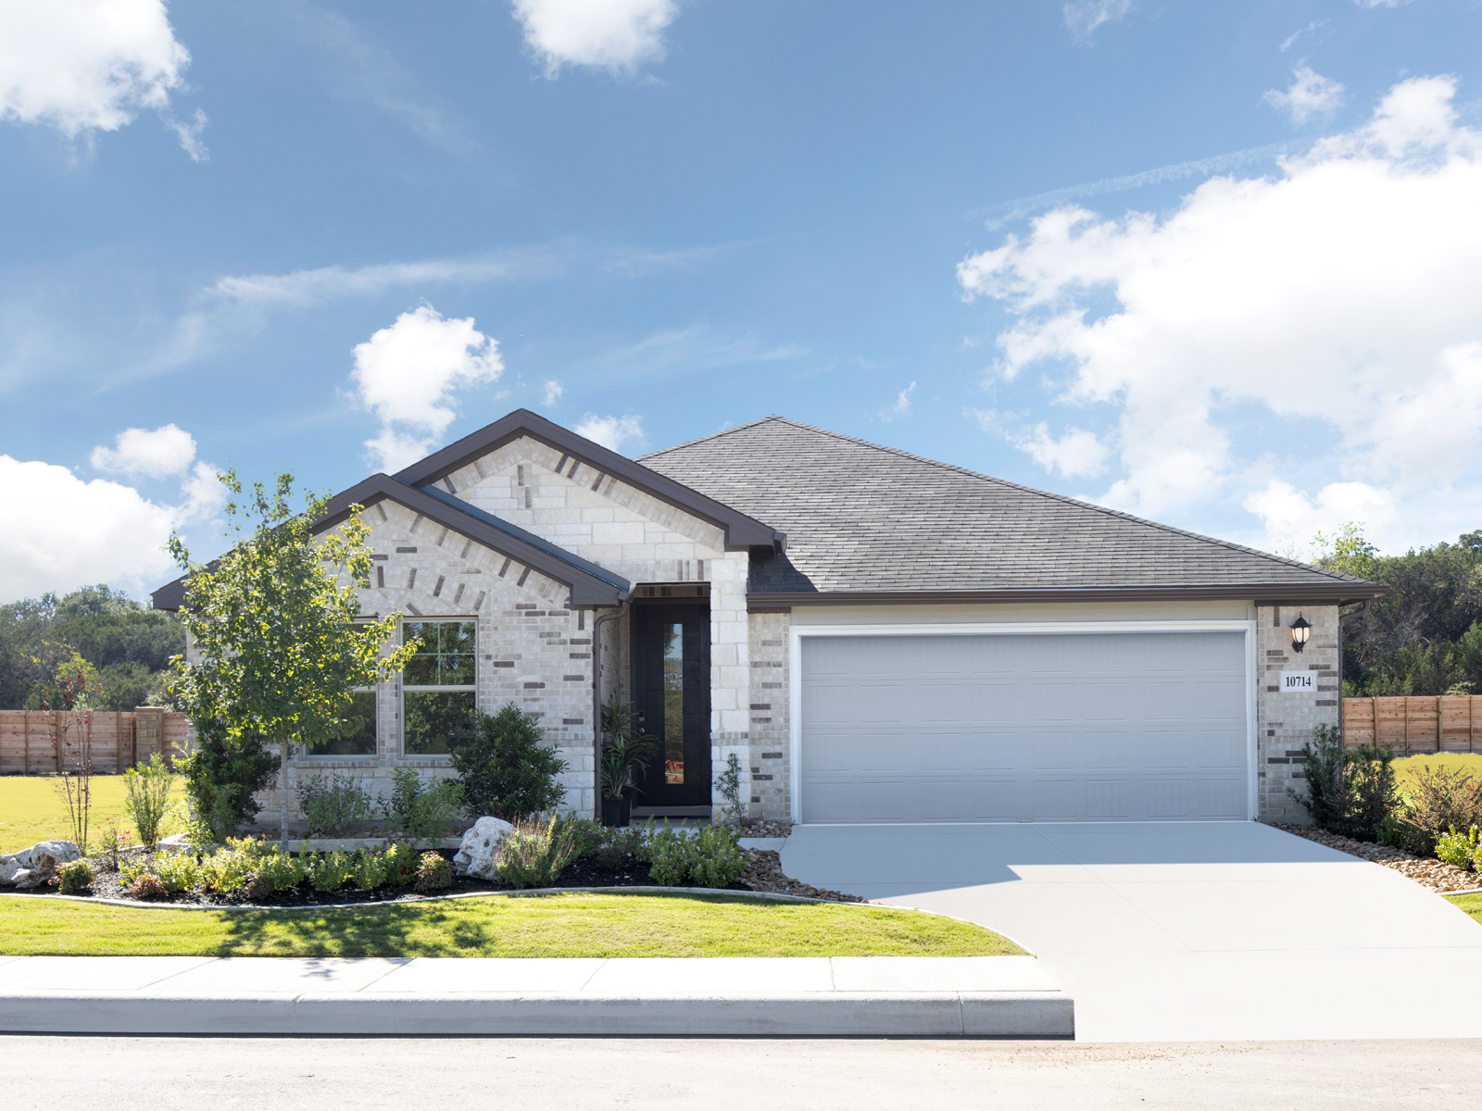
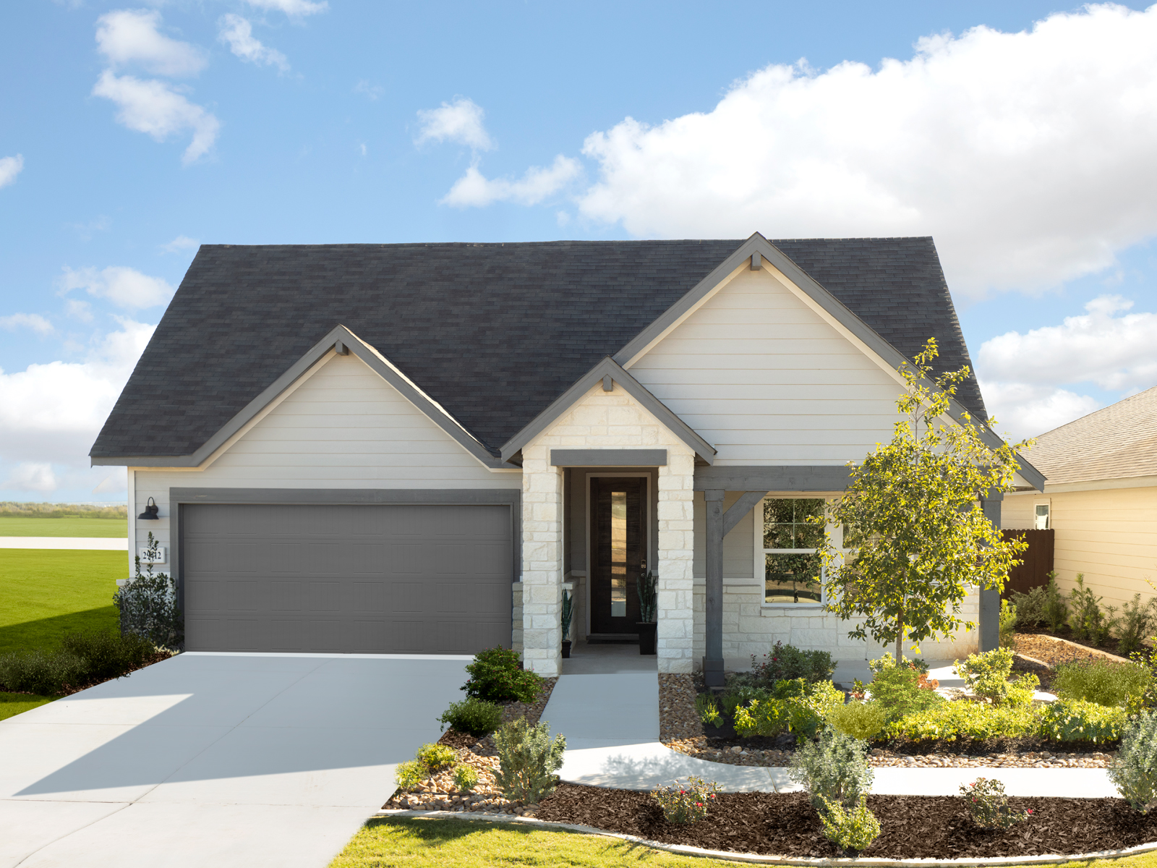
What We build

Slide 5
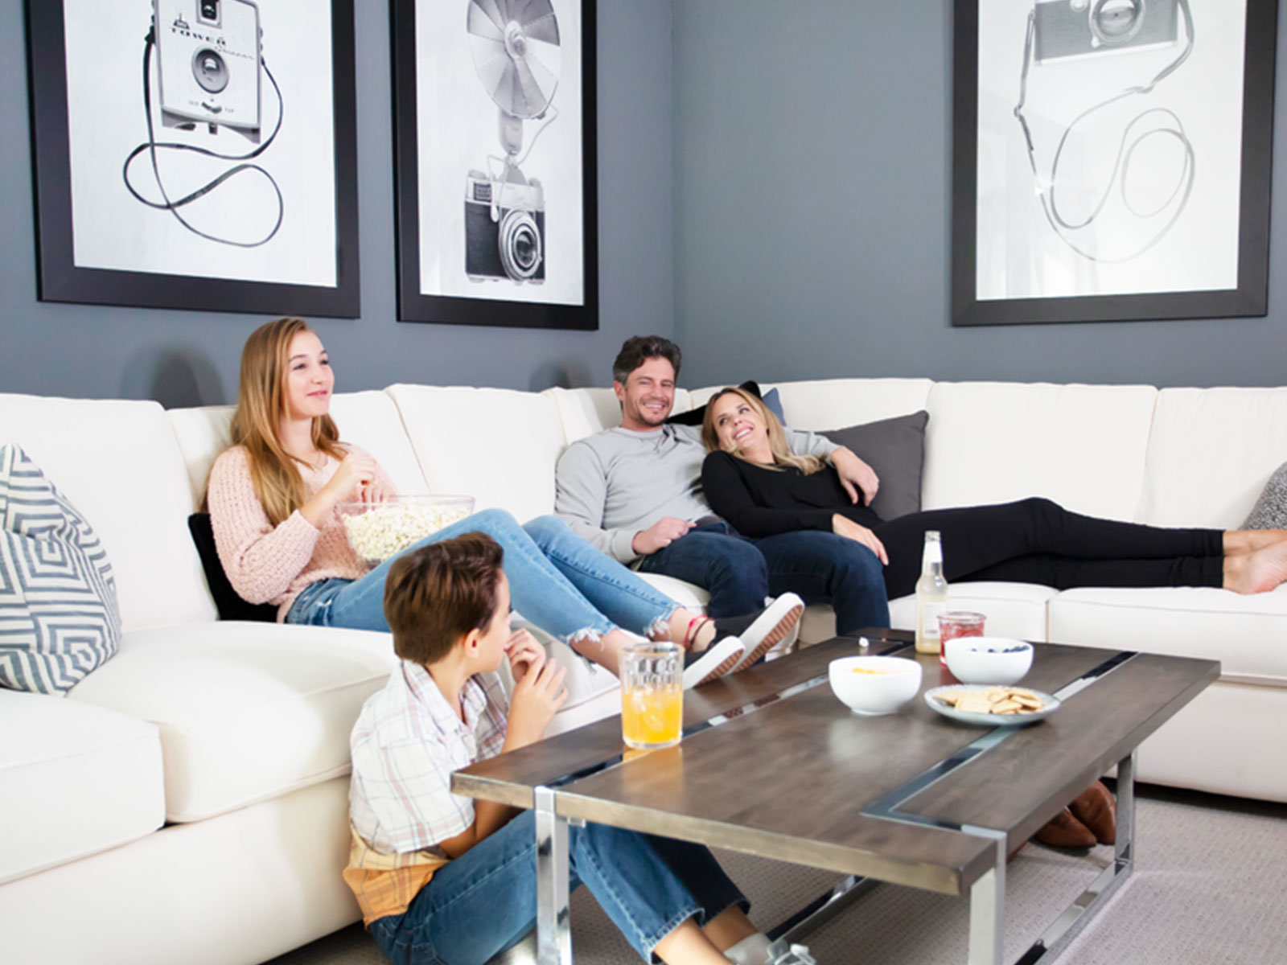
MORE SAVINGS
Live with more savings because your home is built smarter, saving you money each month.
Experience just a few of those saving features through:
Water-Saving Features
Advanced Building Techniques
UV-Blocking Windows
Climate Sealed Homes
Notes:
Two Content

Slide 6
BETTER HEALTH
Live with better health because your home has fresher air, fewer allergens and less pests.
Experience better health through:
Fresh Air Management
Health-Promoting Barrier
High-Performance Air Filtration
Healthier Building Materials
Notes:
Two Content

Slide 7
REAL COMFORT
Live with real comfort because your home is a cozy retreat from the outside world.
Experience increased comfort through:
Temperature-Regulating Features
All-Season Windows
Noise-Reducing Spray Foam
Notes:
Two Content

Slide 8
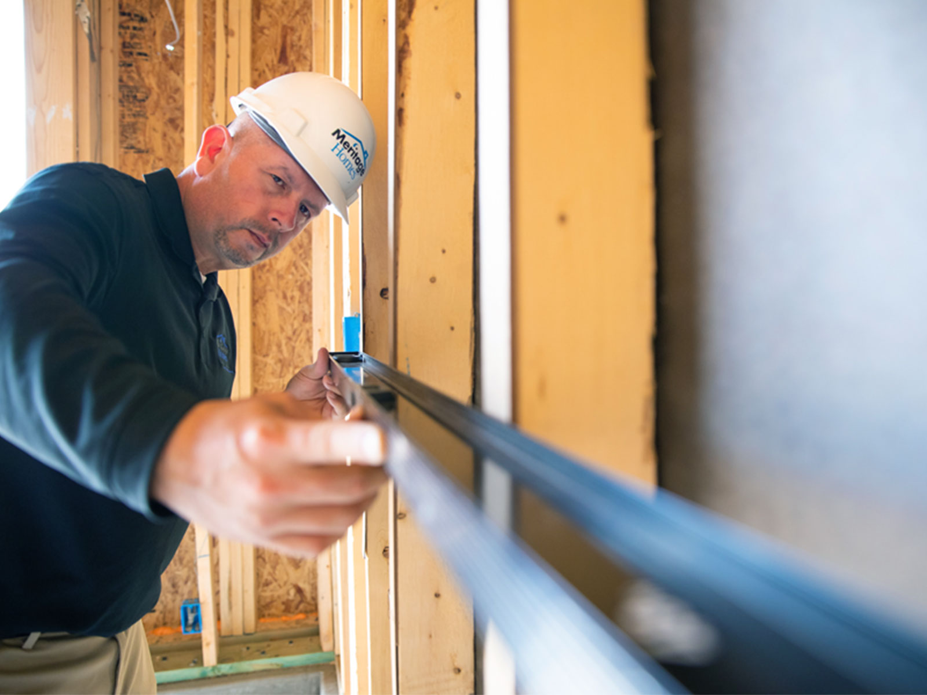
PEACE OF MIND
Live with peace of mind because you have an industry leader in your corner making sure it’s done right.
Experience more peace of mind through:
Smarter Homes
Over 35 years of Experience and Expertise
Higher Standards
Proven Success
Notes:
Two Content

Slide 9
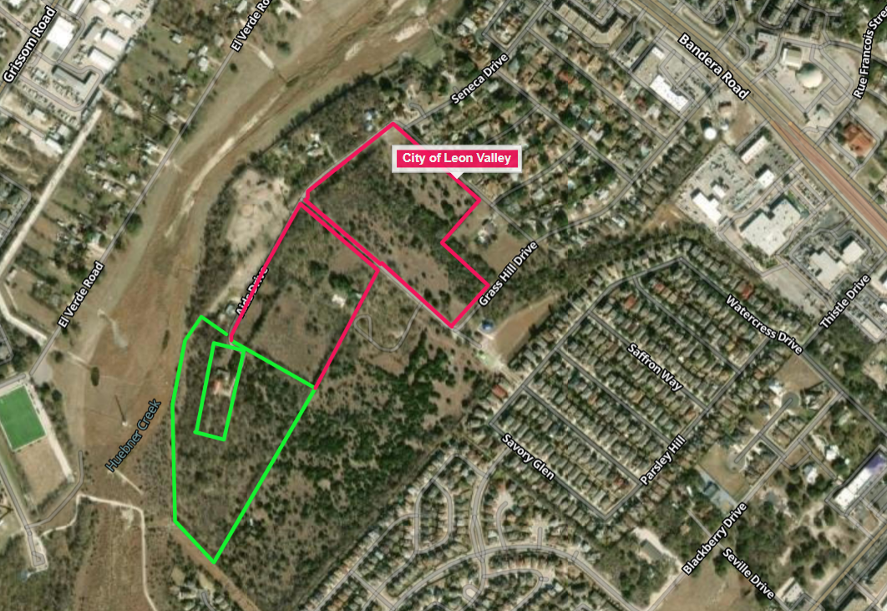
Land tract outline
Notes:
Two Content

Slide 10
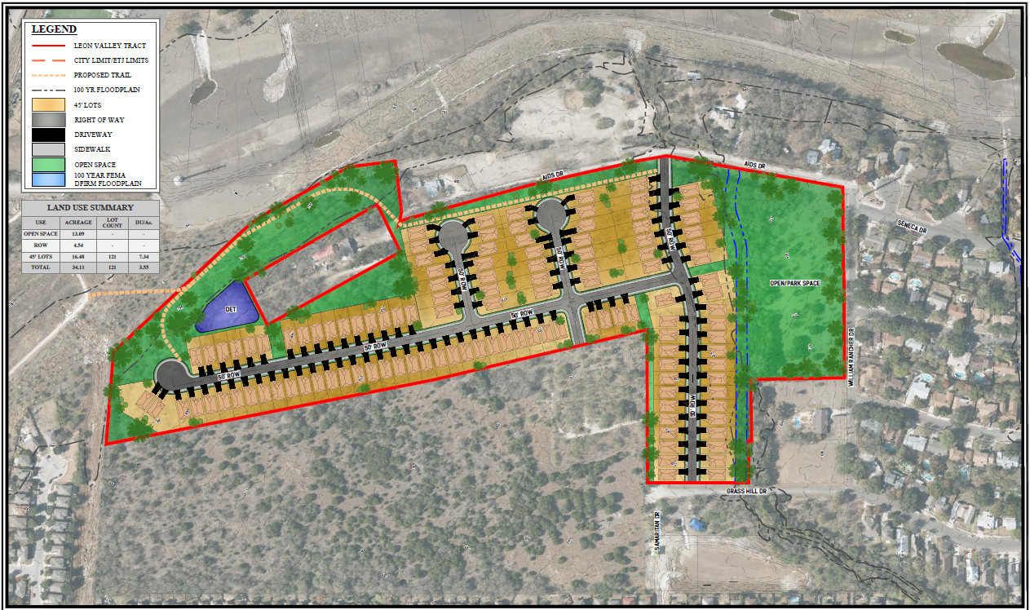
Notes:
Two Content

Slide 11
Why meritage:
+/- 121 Single family, energy efficient, quality built Meritage homes.
Less traffic impact than commercial, townhomes, or multifamily uses.
Dedicated park space.
New walking trails that connect to Huebner Creek Greenway.
Notes:
Two Content

